Slide 1



Advances in statistical methods for
(gene) set enrichment analysis
Roland Nilsson
May 25th, 2010

Slide 2
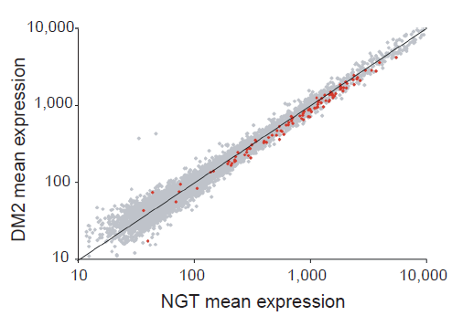
Why gene set enrichment analysis
Find trends in data that correlate with ”functional groups” of genes
Aggregation over gene sets reduces multiplicity and can increase power
Mootha et al., Nat Genet 34:267–273 (2003)

Slide 3
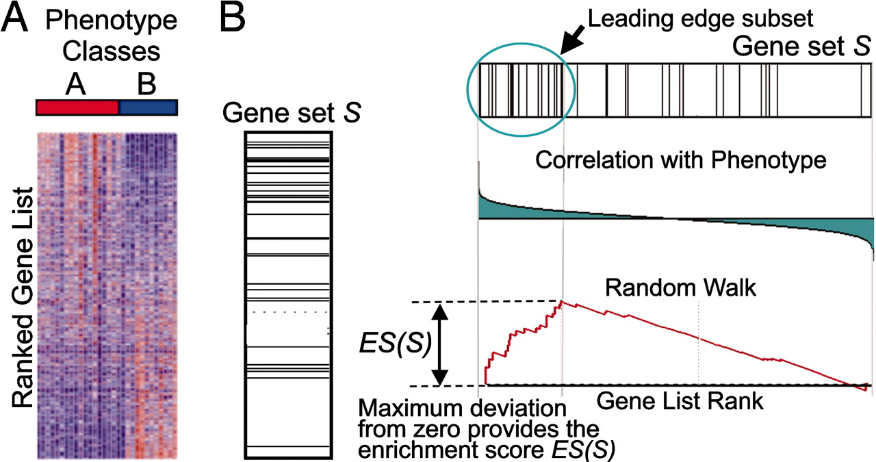
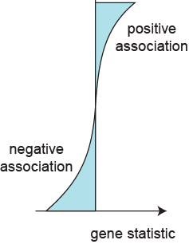
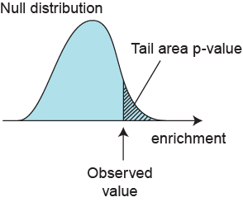
Overview of enrichment analysis
Predefined gene sets
Modified from: Subramanian et al.
PNAS 102:15545--1550 (2005)

Slide 4
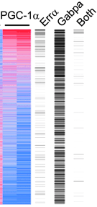
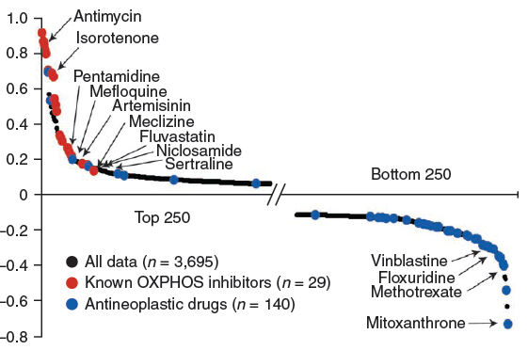
Other examples
Promoter motifs
Compound screening
Relative cell growth
on glucose vs. galactose
Gene induction 3-days
After PGC-1a overexpression
Mootha et al., PNAS 101:6570–6575 (2004)
Gohil et al., Nat Biotech 28:249–255 (2010)

Slide 5
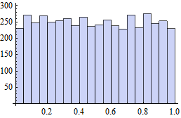
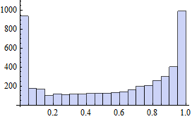
Two very different questions
Q1: are there genes in set S that correlate with the phenotype?
Q2: are the genes in set S more strongly correlated with the phenotype than a random set of genes of the same size?
Q2 does not imply Q1 !
Q1 is addressed by permuting samples
Q2 is addressed by re-sampling genes
  This requires independence of gene statistics under H0
Sometimes only Q2 is testable
Independent
Dependent
Bin counts
Bin counts
Gene set P-values
Gene set P-values

Slide 6
Choice of gene-level statistic
Base statistic: fold-change, z-score, pearson correlation, etc.
Keep positive/negative values separate?

Slide 7
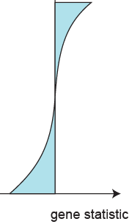
Cutoff methods
Simple cutoff / step function
cutoff at K genes
x genes from S above cutoff
N genes total
M genes in gene set S
Null hypothesis: ranks of genes in S are random sample from {1 ... N }
→ classic urn model: X ~ hypergeometric(N, K, M)
How do we find the parameter K ?
  Set K based on gene-level significance
  Discards information, conservative
Beißbarth & Speed, Bioinformatics 20:1464–1465 (2010)

Slide 8
Rank-based methods
Aggregation of ranks
r_{g}
Compound measure
F(r_{g} )
t_{g}
Mann-Whitney U statistic (rank sum)
GSEA (modified one-sided Kolmogorov-Smirnov)
These statistics are designed based on Q2
Barry et al, Bioinformatics 21:1943–1949 (2005)
Subramanian et al., PNAS 102:15545--1550 (2005)
Mootha et al., Nat Genet 34:267–273 (2003)

Slide 9
Aggregation of gene statistics
Sums, medians, Efron’s max-mean, etc.
r_{g}
Compound measure
F(t_{g} )
t_{g}
Typically based on independent gene statistics assumption
  Power depends strongly on |S|
Difficult to compare statistics between data sets
Pavlidis et al., Pac Symb Biocomp 2002, 474–485
Tian et al., PNAS 102:13544–13549 (2005)
Efron and Tibshirani, Ann Appl Stat 1:107–129 (2007)

Slide 10

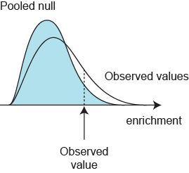
False discovery rate control
For each gene set S, compute permutation p-value
FDR correction
(e.g. Benjamini-Hochberg)
x M gene sets
Pooling permuted statistics
Tail ratio FDR
Efron and Tibshirani, Ann Appl Stat 1:107–129 (2007)

Slide 11
Comparative studies
Table 3
Efron & Tibshirani 2007
  Advocates the max-min statistic
  Does not consider the ”competitive” Q2 hypothesis
Ackermann & Strimmer 2009
  Advocates rank sum statistics; GSEA statistic exhibits low power
  focus on gene re-sampling
  Simulations did not include correlated p-values under the null
Efron and Tibshirani
Ann Appl Stat 1:107–129 (2007)
 | mean | max-mean | median | GSEA | cond. FDR | Rank sum
set 1 | 0.67 | 0.67 | 0.82 | 0.56 | 0.68 | 0.84
set 2 | 0.92 | 0.93 | 0.98 | 0.65 | 0.94 | 1.00
set 3 | 0.01 | 0.01 | 0.00 | 0.00 | 0.01 | 0.01
set 4 | 0.44 | 0.45 | 0.57 | 0.35 | 0.45 | 0.54
set 5 | 0.41 | 0.41 | 0.32 | 0.22 | 0.42 | 0.41
set 6 | 0.85 | 0.86 | 0.94 | 0.80 | 0.85 | 0.96
set 7 | 1.00 | 1.00 | 1.00 | 0.99 | 1.00 | 1.00
set 8 | 0.70 | 0.71 | 0.78 | 0.65 | 0.84 | 0.74
set 9 | 0.90 | 0.86 | 0.81 | 0.69 | 0.99 | 0.80
Ackermann & Strimmer, BMC Bioinformatics 10:47 (2009)
Song & Black, BMC Bioinformatics 9:502 (2008)

Slide 12
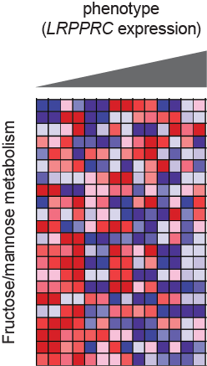

What’s driving the enrichment?
Re-test individual genes within a significant gene set S
Selection bias problems
”Leading edge”

Slide 13
What gene sets to test?
Publicly available databases, e.g. mSigDB
Often several highly overlapping gene sets → unnecessary multiplicity
Gene set curation is not perfect ...
HSA00190_OXIDATIVE_PHOSPHORYLATION (KEGG)
ATP12A | ATP6V0A1 | ATP6V1H | COX7B2 | NDUFA3 | NDUFC1 | UCRC
ATP4A | ATP6V0A2 | ATP8 | COX7C | NDUFA4 | NDUFC2 | UQCR
ATP4B | ATP6V0A4 | COX1 | COX8A | NDUFA4L2 | NDUFS1 | UQCRB
ATP5A1 | ATP6V0B | COX10 | COX8C | NDUFA5 | NDUFS2 | UQCRC1
ATP5B | ATP6V0C | COX15 | CYC1 | NDUFA6 | NDUFS3 | UQCRC2
ATP5C1 | ATP6V0D1 | COX17 | CYTB | NDUFA7 | NDUFS4 | UQCRFS1
ATP5D | ATP6V0D2 | COX2 | LHPP | NDUFA8 | NDUFS5 | UQCRH
ATP5E | ATP6V0E1 | COX3 | ND1 | NDUFA9 | NDUFS6 | UQCRQ
ATP5F1 | ATP6V1A | COX4I1 | ND2 | NDUFAB1 | NDUFS7
ATP5G1 | ATP6V1B1 | COX4I2 | ND3 | NDUFB1 | NDUFS8
ATP5G2 | ATP6V1B2 | COX5A | ND4 | NDUFB10 | NDUFV1
ATP5G3 | ATP6V1C1 | COX5B | ND4L | NDUFB11 | NDUFV2
ATP5H | ATP6V1C2 | COX6A1 | ND5 | NDUFB2 | NDUFV3
ATP5I | ATP6V1D | COX6A2 | ND6 | NDUFB3 | PPA1
ATP5J | ATP6V1E1 | COX6B1 | NDUFA1 | NDUFB4 | PPA2
ATP5J2 | ATP6V1E2 | COX6B2 | NDUFA10 | NDUFB5 | SDHA
ATP5L | ATP6V1F | COX6C | NDUFA11 | NDUFB6 | SDHB
ATP5O | ATP6V1G1 | COX7A1 | NDUFA12 | NDUFB7 | SDHC
ATP6 | ATP6V1G2 | COX7A2 | NDUFA13 | NDUFB8 | SDHD
ATP6AP1 | ATP6V1G3 | COX7B | NDUFA2 | NDUFB9 | TCIRG1

Slide 14
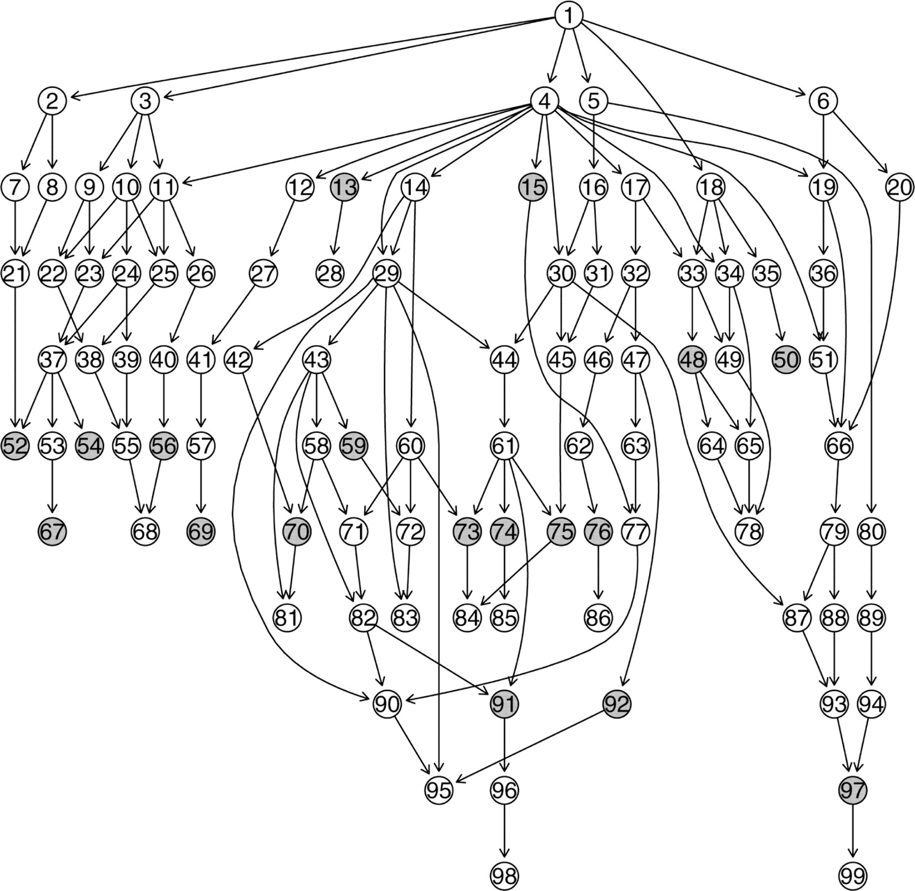
Structured testing
Testing on the GeneOntology subset graph
  Find the most specific gene sets for which the null can be rejected
  Only applies to Q1 testing
  Controls FWER
Goeman & Mansmann,
Bioinformatics 24:537–544 (2008)

Slide 15
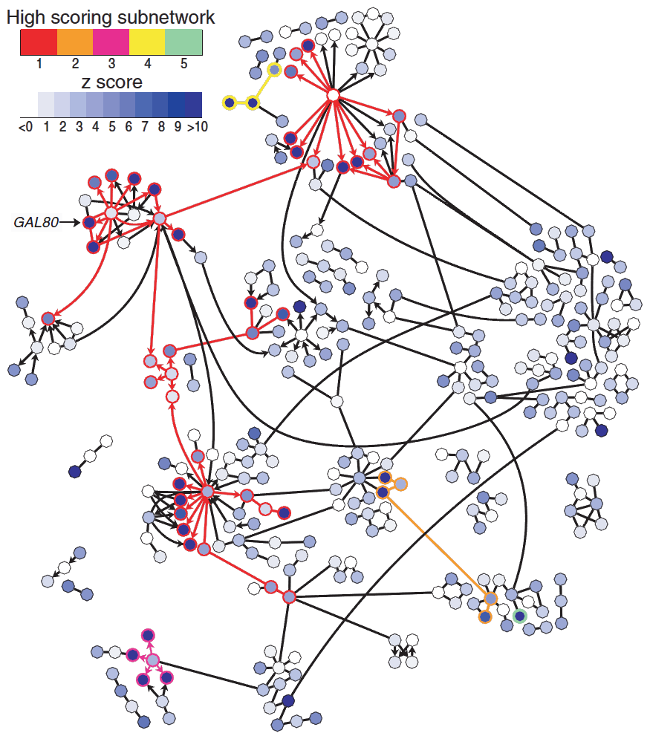
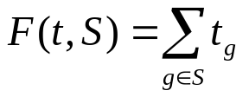
Beyond gene sets ...
Might be more appropriate to encode prior information as a network (graph)
”Network enrichment” statistic:
find gene set S that maximizes a score
NP-hard, but exact solution is possible
using integer linear programming
Significance assessment usually by
gene permutations (Q2 !)
Ideker et al., Bioinformatics 18:S223–S240 (2002)
Dittrich et al., Bioinformatics 24:i223–i231 (2008)

Slide 16
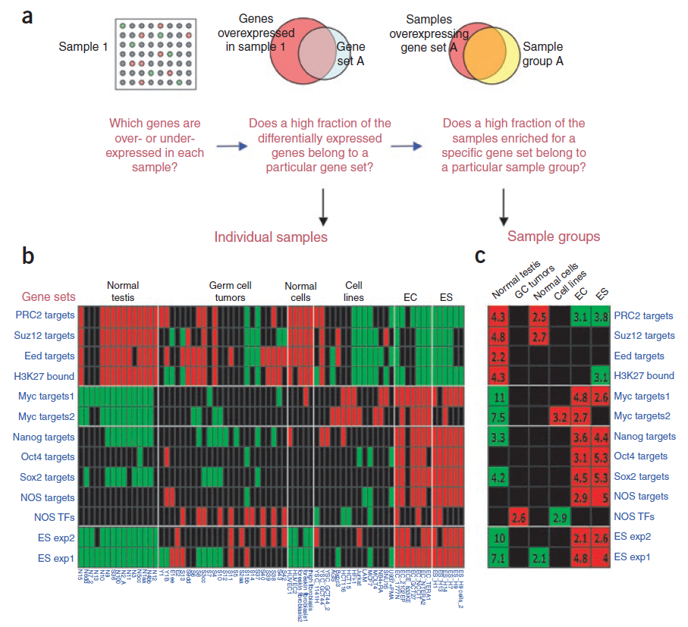
Further analysis of enrichment results
Ben-Porath et al., Nat Genet 40:449–507 (2002)

Slide 17
Some (subjective) recommendations
Rank-based methods have good power, generally applicable
Simple aggregation measures work well, e.g. rank sum
  But the K parameter problem seems unavoidable
Use sample permutations for significance testing if possible
  Can be combined with ”competitive” (Q2) statistics (rank sum)
Pooled gene set statistics are hard to interpret

